Slide 1
Twitter Bot
Boqi Gao
Shangshang Han
Minlin Zhang
Junlin Wang

Slide 2
What we need ?
A Twitter account
Tweepy
PIL

Slide 3
Access to the Twitter

Slide 4
Streaming With Tweepy

Slide 5
Scramble Image Pixel

Slide 6
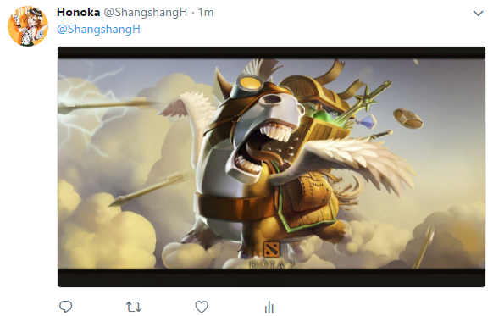
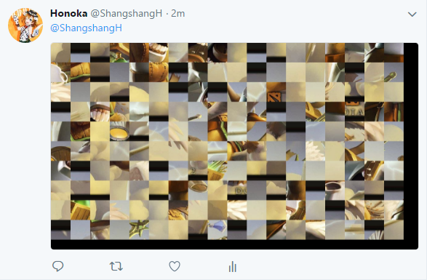
Results

Slide 7
Connect us:
bgao1@stevens.edu
shan13@stevens.edu
mzhang27@stevens.edu
jwang135@stevens.edu

